Slide 1


NONVERBAL DELIVERY
Session IV. Group & Team Theory

Slide 2

Learning objectives
Demonstrate
Demonstrate how to use movement to increase the effectiveness of your presentation.
Demonstrate
Demonstrate how to use visual aids effectively in your presentation.
Demonstrate
Demonstrate three ways to improve nonverbal communication.

Slide 3

Chapter outline
1. Nonverbal communication definition
2. Types of nonverbal communication
3. Movement in Your Speech
4. Visual Aids
5. Nonverbal Strategies for Success with Your Audience

Slide 4
1. Nonverbal Communication Is Fluid
Nonverbal communication is the process of conveying a message without the use of words.
Include:
Gestures
Facial expressions
Tone of voice
Timing
Posture
and where you stand as you communicate.
Notes:
It can help or hinder the clear understanding of your message, but it doesn’t reveal (and can even mask) what you are really thinking.

Slide 5
2. Eight types of nonverbal communication
1. Space
2. Time
3. Physical characteristics
4. Body movements
5. Touch
6. Paralanguage
7. Artifacts
8. Environment

Slide 6
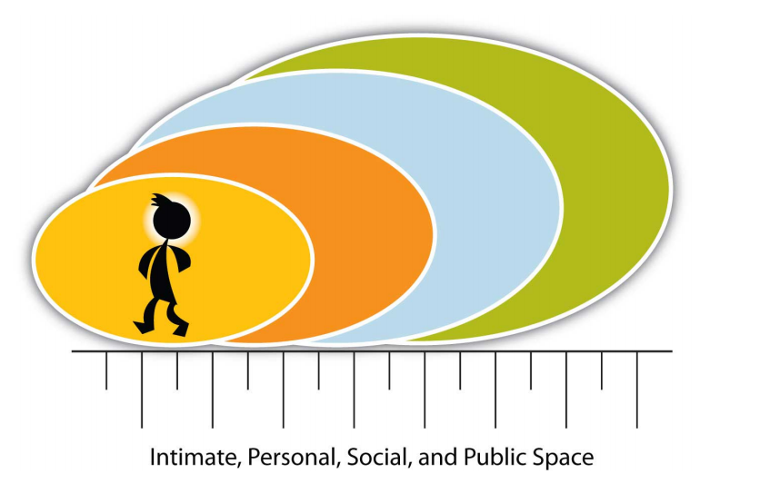
Space

Slide 7

Environment
Environment involves the physical and psychological aspects of the communication context.
The perception of one’s environment influences one’s reaction to it.
The results produced in the environment, designed to facilitate creativity, interaction, and collaboration, are worth the effort.

Slide 8

3. Movement in Your Speech
Let’s start with behaviors to avoid:
Who would you rather listen to: a speaker who moves confidently across the stage or one who hides behind the podium; one who expresses herself nonverbally with purpose and meaning or one who crosses his arms or clings to the lectern?
Audiences are most likely to respond positively to open, dynamic speakers who convey the feeling of being at ease with their bodies.

Slide 9
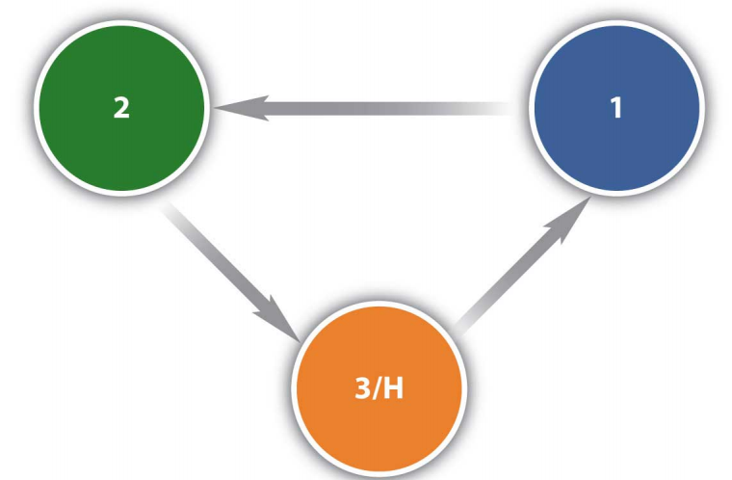
Positions on the Stage
The speaker’s triangle indicates where the speaker starts in the introduction (1)
Moves to the second position for the first point (2)
Across for the second point (1)
Then returns to the original position to make the third point and conclusion (1)

Slide 10

Gestures
Gestures involve using your arms and hands while communicating.
Anticipation step: speakers lead up to a main point, they raise their hand slightly, perhaps waist high.
Implementation step: using your arms and hands above your waist.
Relaxation step: the letting go motion complements your residual message, concludes the motion.

Slide 11
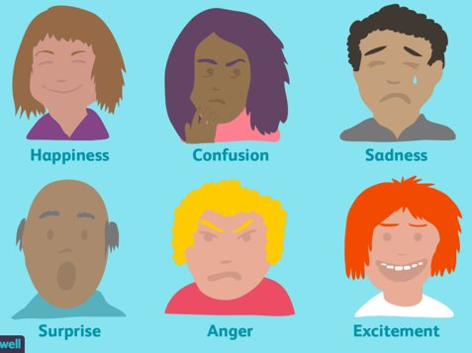
Facial Gestures
Facial gestures involve using your face to display feelings and attitudes nonverbally.
They may reinforce, or contradict, the spoken word, and their impact cannot be underestimated.
Facial gestures should reflect the tone and emotion of your verbal communication.
Eye contact: The single most important facial gesture; it refers to the speaker’s gaze that engages the audience members.

Slide 12
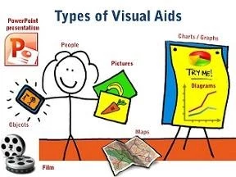
4. Visual Aids
Visual aids are an important nonverbal aspect of your speech that you can control.
Include:
Handouts
Overhead transparencies
Drawings on the whiteboard
PowerPoint slides
And many other types of props.

Slide 13
Visual aids accomplish several goals:
Make your speech more interesting
Enhance your credibility as a speaker
Serve as guides to transitions, helping the audience stay on track
Communicate complex or intriguing information in a short period of time
Reinforce your verbal message
Help the audience use and retain the information

Slide 14
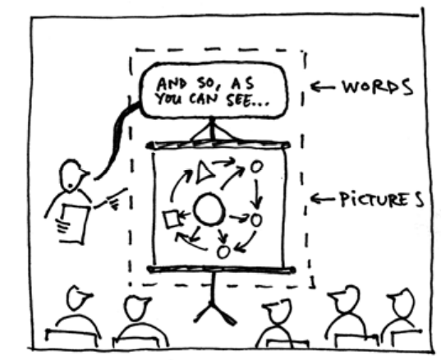
Purpose, Emphasis, Support, and Clarity
The purpose for each visual aid should be clear, and almost speak for itself.
Visual aids provide necessary support for your position, illustrate relationships, and demonstrate trends

Slide 15
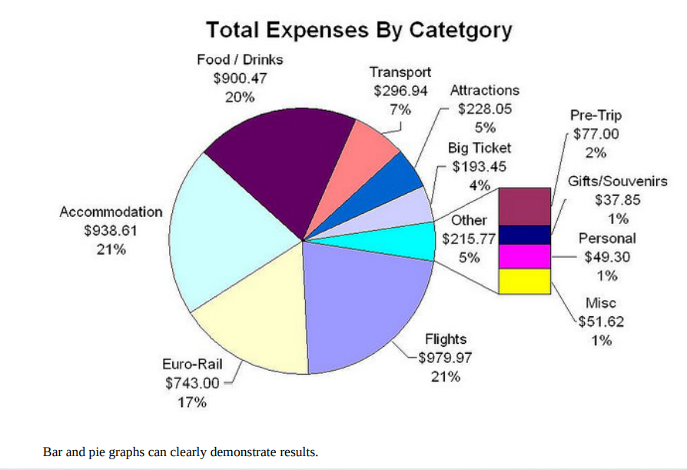
Methods and Materials
Chart or Diagram: to show a timeline of events to date.
Bar or Pie graph: to show the percentage.
Pictures
Map
Sound and music
Video clips
Flip charts
Handouts
Transparencies and slides
….

Slide 16
Preparing Visual Aids
Your visual aids should meet the following criteria:
Big: They should be eligible for everyone, and should be “back row certified.”
Clear: Your audience should “get it” the first time they see it.
Simple: They should serve to simplify the concepts they illustrate.
Consistent: They should reinforce continuity by using the same visual style.

Slide 17
Using Visual Aids
Here are some Dos and Don’ts:
Do make a clear connection between your words and the visual aid for the audience.
Do not distract the audience with your visual aid, blocking their view of you or adjusting the visual aid repeatedly while trying to speak.
Do speak to your audience—not to the whiteboard, the video, or other visual aids.

Slide 18
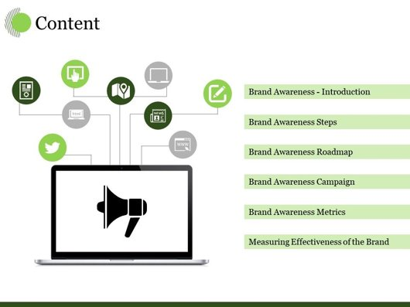
Using PowerPoint as a Visual Aid
How you prepare your slides and use the tool will determine your effectiveness.

Slide 19

Use of Color
People love color, and will appreciate the visual stimulation of a colorful presentation.
The color can also distract and turn off an audience.
You will be selecting which color you want to use for headers or key words, and how they relate the colors in the visual images.

Slide 20
Helpful Hints for Visual Aids
Keep visual aids simple.
Use one key idea per slide.
Avoid clutter, noise, and overwhelming slides.
Use large, bold fonts that the audience can read from at least twenty feet from the screen.
Use contrasting colors to create a dynamic effect
Use analogous colors to unify your presentation.
Use clip art with permission and sparingly.
Edit and proofread each slide with care and caution.
Use copies of your visuals available as handouts after your presentation.
Check the presentation room beforehand.
Have a backup plan

Slide 21
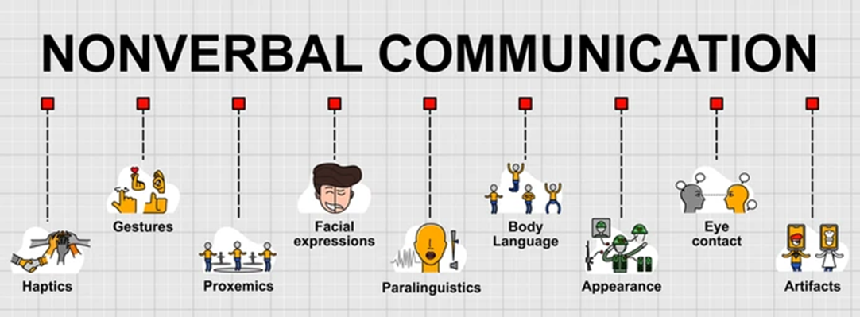
5. Nonverbal Strategies for Success with Your Audience
Watch Reactions
Enroll an Observer
Focus on a Specific Type of Nonverbal Communication

Slide 22
Exercises
1. Watch a television program without the sound. Can you understand the program? Write a description of the program and include what you found easy to understand, and what presented a challenge, and present it to the class.
2. Observe communication in your environment. Focus on specific actions like face touching, blink rate, or head nodding and write a brief description of what you observe. Share with classmates.
3. Interview someone from a different culture than your own and ask them to share a specific cultural difference in nonverbal communication—for example, a nonverbal gesture that is not used in polite company. Write a brief description and present it to the class.

Slide 23
